Slide 1


Modular Robot Time Protocol (MRTP)
Time synchronization for programmable matter based modular robots
Bogdan Gorelkin
Hassan Hijazi
Univ. of Franche-Comté / IUT-BM
Jury de soutenance:
Abdallah Makhoul
Montbéliard 2020

Slide 2
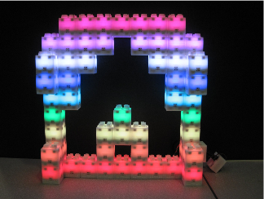
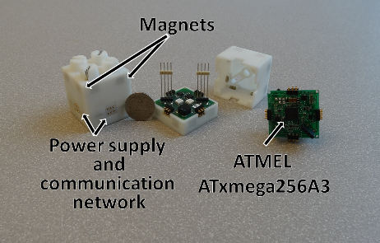
Modular Robot Time Protocol (MRTP) - a network-wide time synchronization protocol for modular robots.
✓
The maximum number of blink blocks in the network that can be controlled- 27 775
✓
Protocol is able to keep a Blinky Blocks system synchronized to a few milliseconds, using few network resources at runtime, even-though the Blinky Blocks hardware clocks exhibit very poor accuracy and resolution
* protocol reviewed on Blinky Blocks hardware
* the Blinky Blocks are equipped with a very low accuracy (10,000 parts per million (ppm)) and poor resolution (1 millisecond) clocks
1

Slide 3


a common notion of time…
Every module has its own notion of time provided by its own hardware clock
Network-wide time synchronization protocols aim to keep a small offset between local clocks and a global reference time
Distributed time synchronization is necessary to keep each modules local clock synchronized to a global timescale
is the coordination of events to operate a system in unison
2

Slide 4
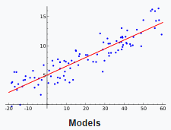
Why Modular Robot Time Protocol (MRTP) is better?
protocol achieves its performance by combining several mechanisms:
central time master election
fast and recursive propagation of synchronization waves along the edges of a breadth-first spanning tree
low-level timestamping with per-hop compensation for communication delays using the most-appropriate method for the target platform
clock skew compensation using linear regression
* Linear regression - is a linear approach to modeling the relationship between a scalar response (or dependent variable) and one or more explanatory variables (or independent variables)
3

Slide 5

MRTP algorithm
begin MRTP
select center
(example ABC-Center)
yes
do we have a new modules?
no
Each module should send the BACK message to his parents*
The time master sets the global timescale as YTM
root as central module master of time
*At each hop, the transmitted time is updated to take into account communication delays and time of residence in intermediate modules
4

Slide 6
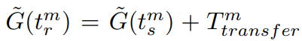
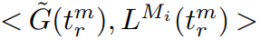
Periodic Synchronization
begin MRTP
the central sends a sync message to its children each parent module, starting from
Y = a * x + b
At each hop, the transmitted time is updated to take into account communication delays and time of residence in intermediate modules. Slave modules use a linear model to compensate for clock skew.
Calculate new Gt using linear equation
Synchronization points for the linear regression are made
5

Slide 7

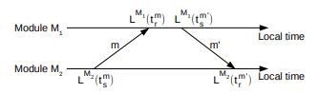
How does it work on schematic
time master
6

Slide 8
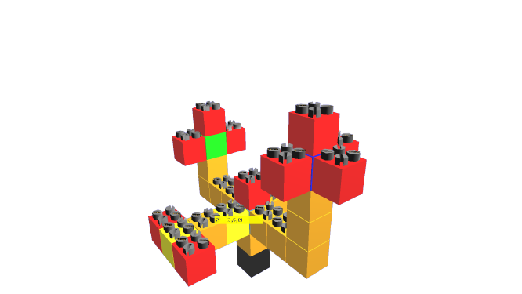
Implementation of algorithm on VisibleSim
Inculcation of Simple Algorithm for Improving Time Synchronization in Wireless Sensor Networks
Tasks to achieve the goal
MRTP
Build the spanning tree
Get BACK_MSG
Broadcast a sync message
Initialize time
Periodic Synchronization
Compute linear regression
7

Slide 9
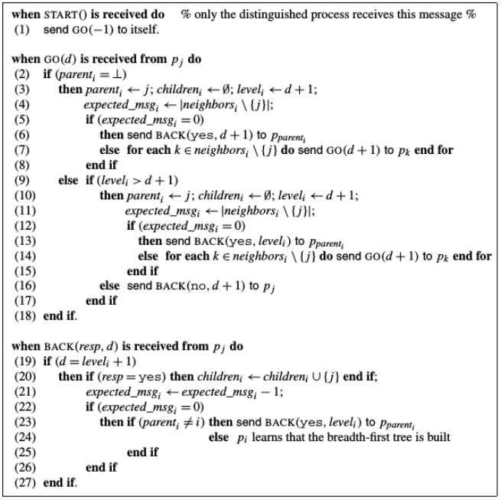
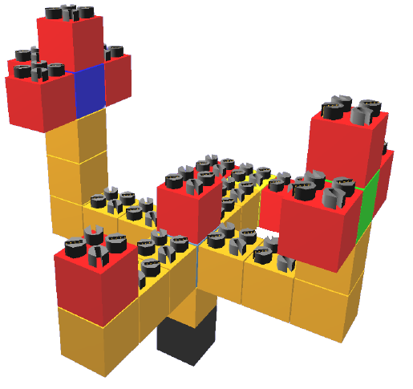
Spanning tree
8

Slide 10
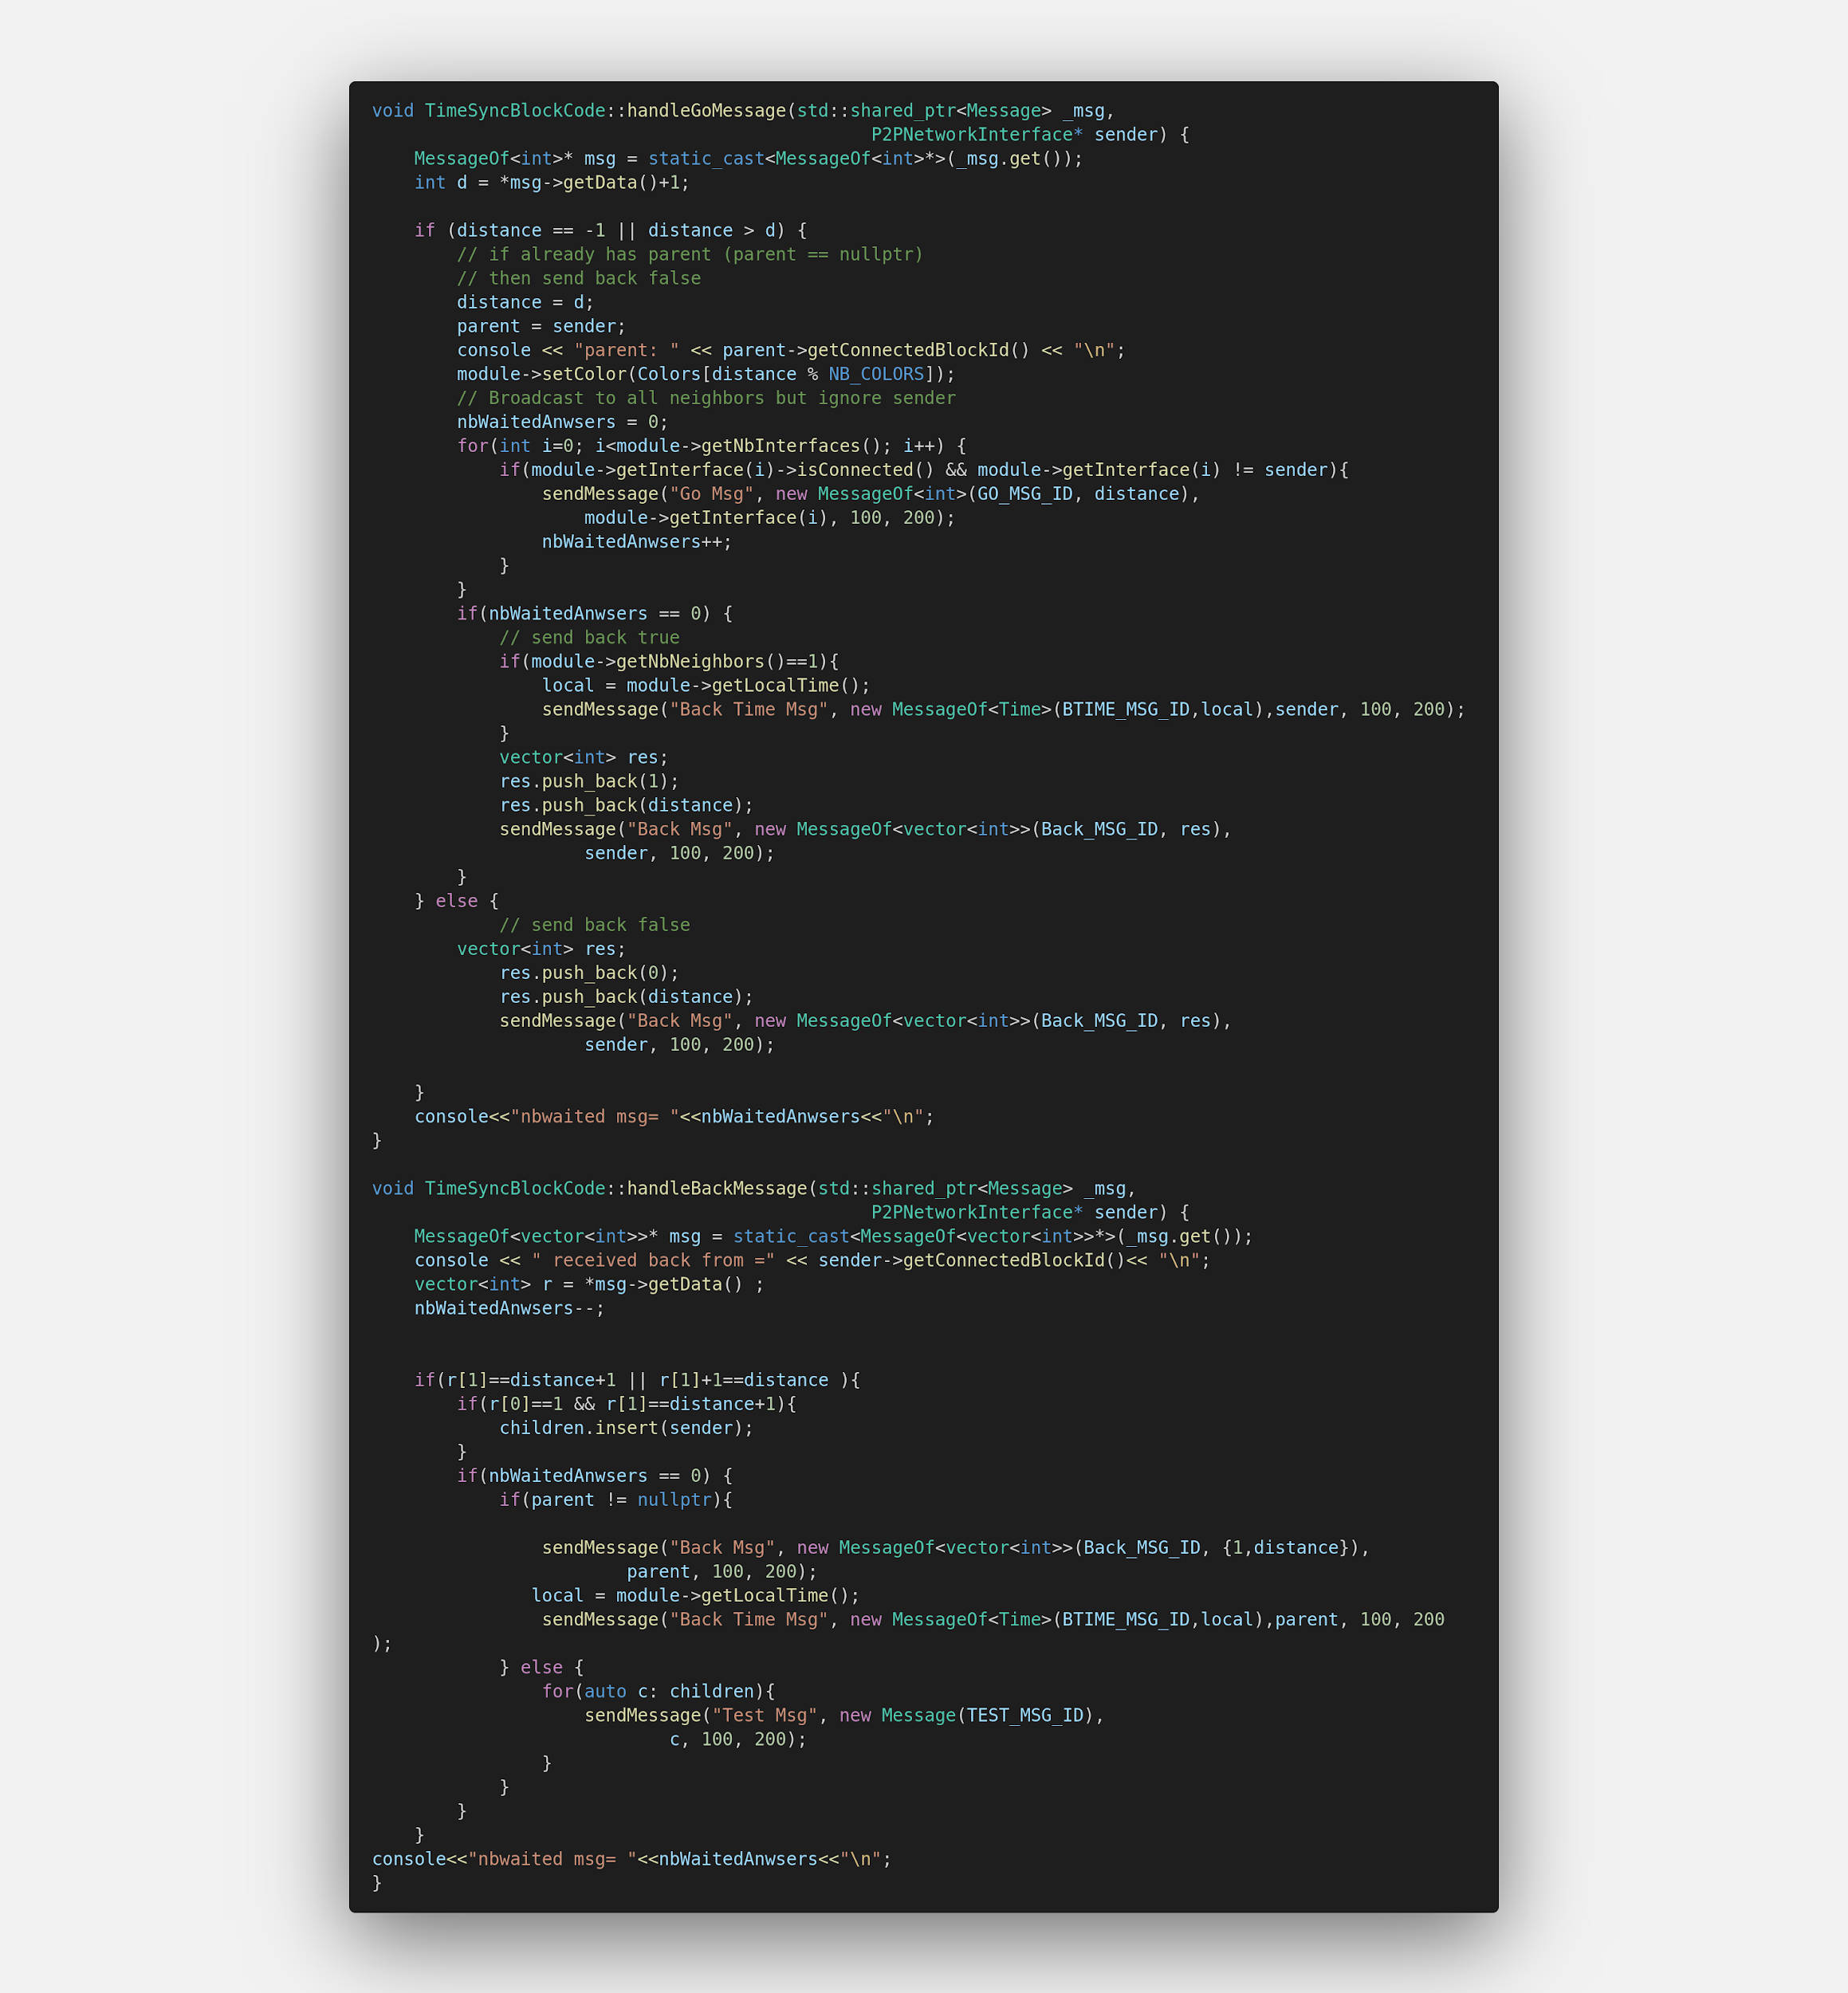
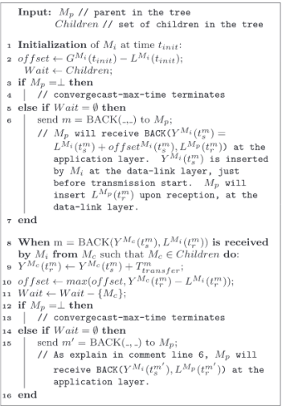
Go message
9

Slide 11
Back message
Summary:
Parent sends GO_MESSAGES to his children
Each children starting from the leafs sends BACK_MESSAGES containing the estimated local time
Each parent wait the Back Message from all his children's and then sent his own back message to his parents (its mean his own local time)
10

Slide 12
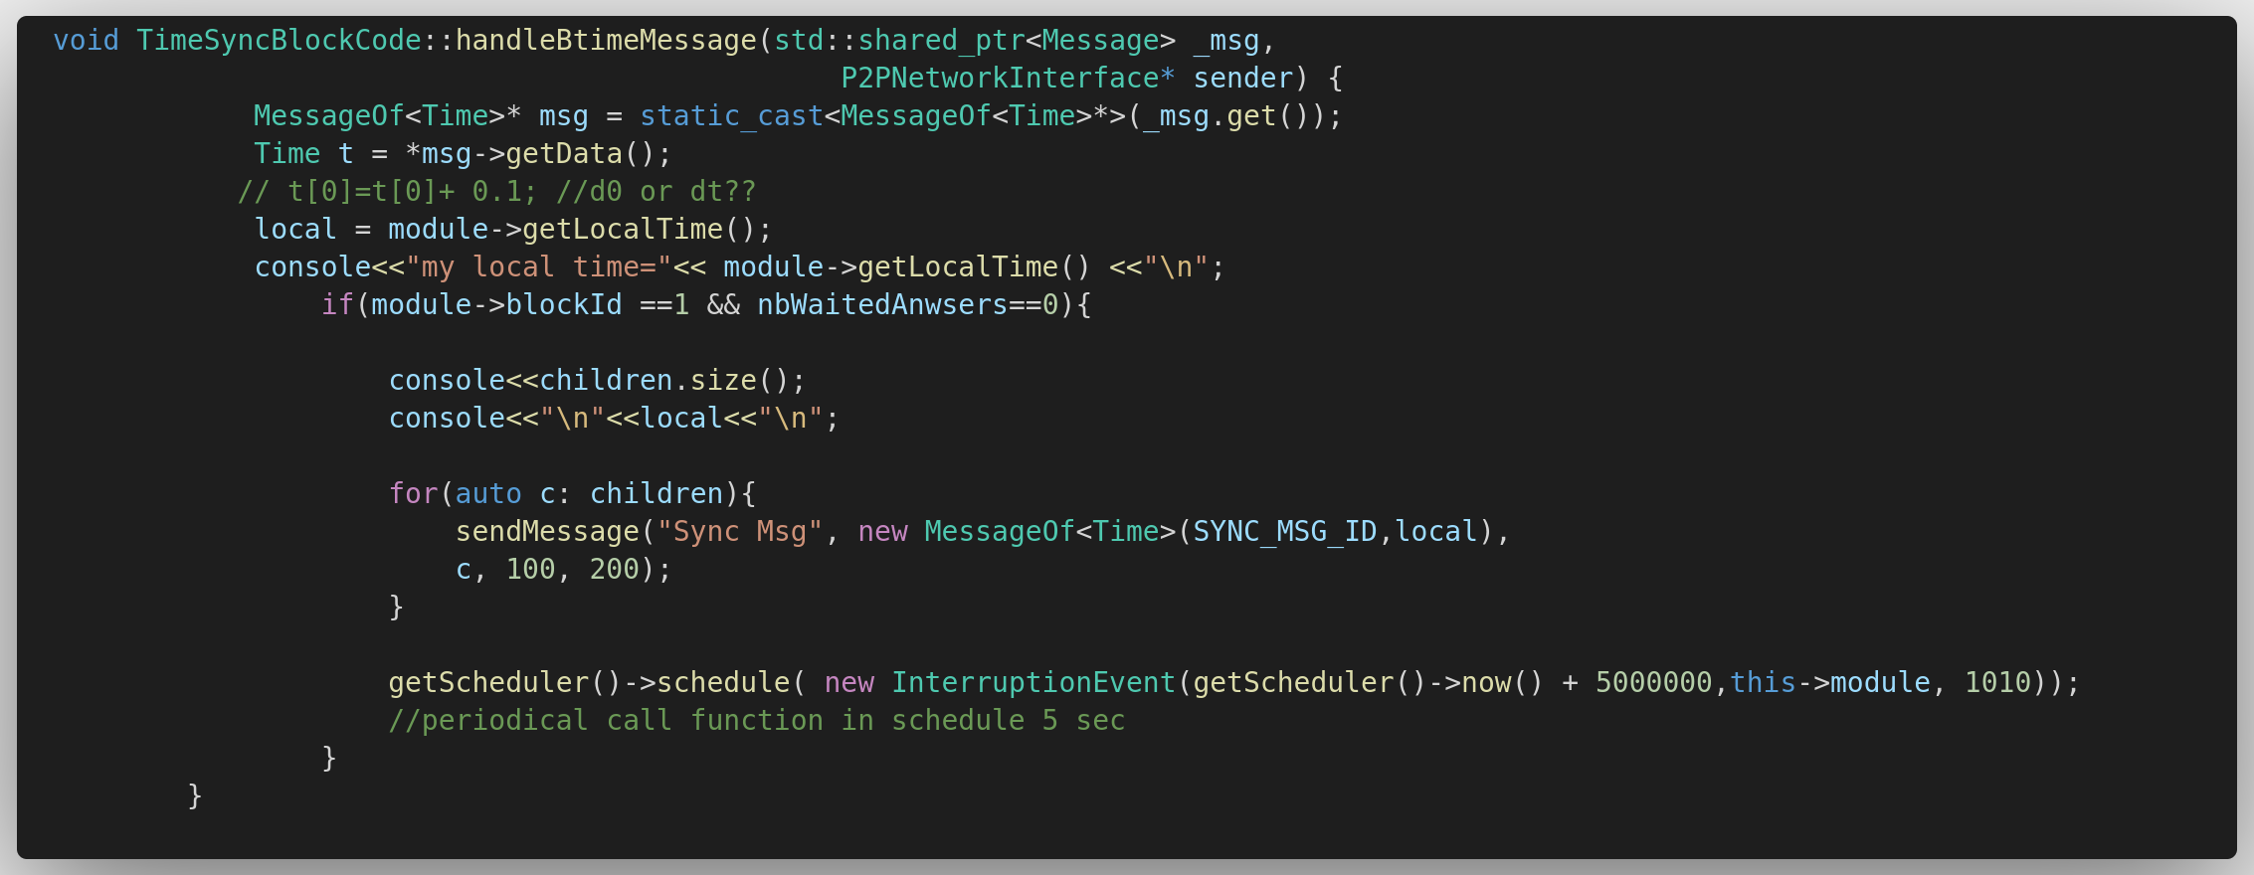
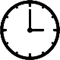
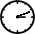
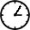
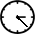
Global Clock Initialization
Leader
3
2
GO MSG
1
maximum time
as a master
time
Leaf 1
Leaf 1
GO MSG
We check the local time of each module and assign time of the module with a greater time as a time master
Leaf 2
GO MSG
2
3
Leaf 3
11
3

Slide 13
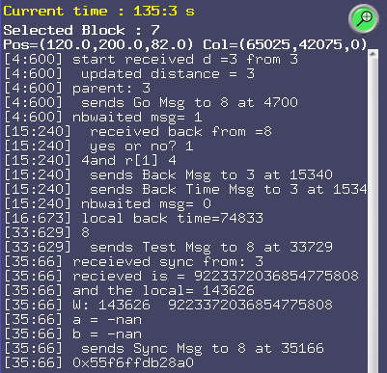
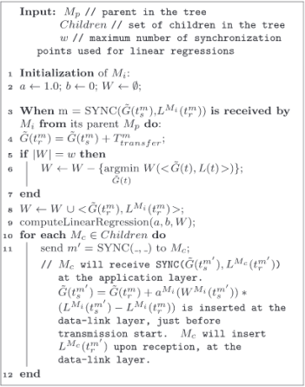
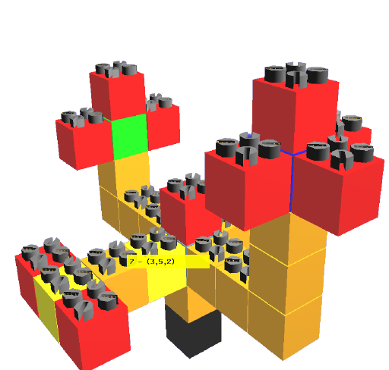
Sync message
Summary:
After the master received last back message:
It will start to broadcast sync message to the tree
The sync message contains the time estimate of the “master time”
This message will be periodically sent.
For what???
12

Slide 14
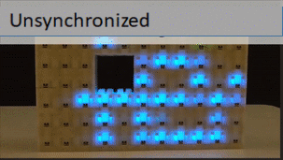
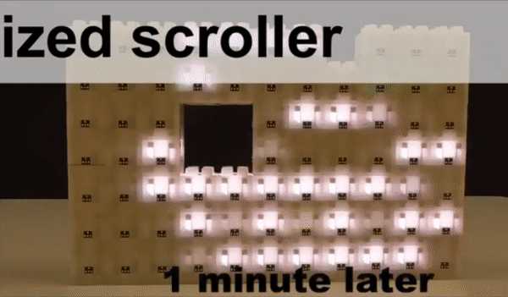
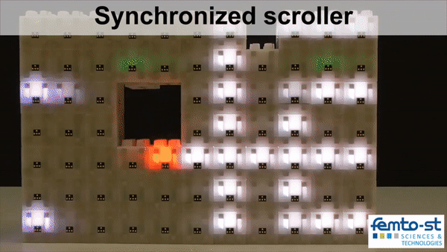
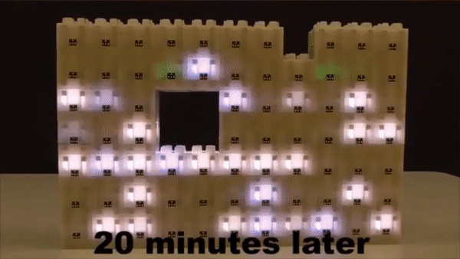
Why do synchronizations matter?
Unsynchronized
Unsynchronized
Unsynchronized
13

Slide 15
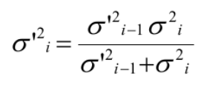
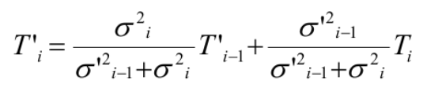
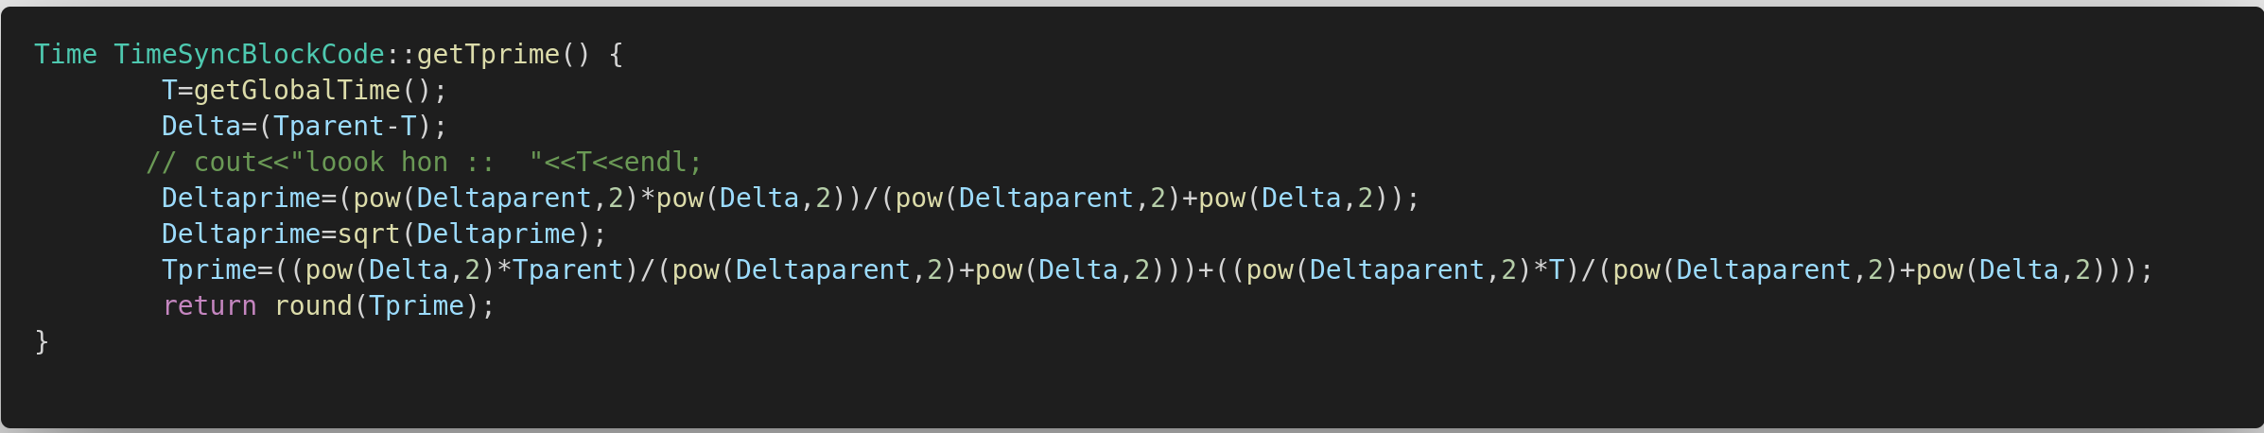
Simple Algorithm for Improving Time Synchronization in Wireless Sensor Networks
According to a scientific publication (2), this algorithm allows you to speed up synchronization by 4-5 times. This is achieved by using the formulas:
14

Slide 16
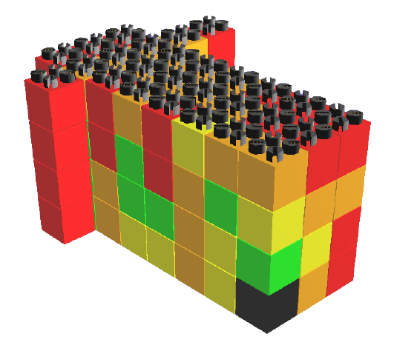
Analysis of the obtained results
The experiment was carried out on several models.
configTree.xml
configCube.xml
to get result we were using follow command:
./[name of project] –c [config file xml] >resultat.txt
15
Seed Block_ID = 1
Seed Block_ID = 1

Slide 17
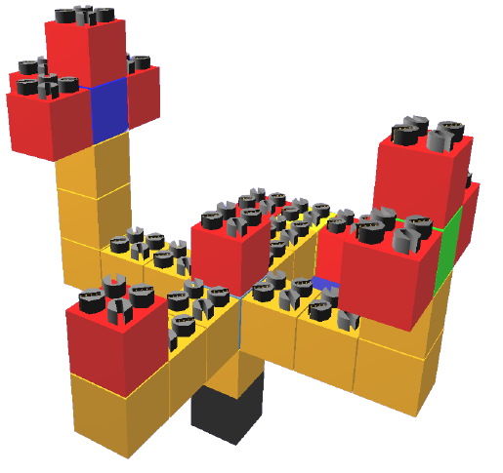
Comparison of sync speed for [configTree.xml] model
MRTP without improving
MRTP with improving
15

Slide 18
Comparison of sync speed for [configCube.xml] model
MRTP without improving
MRTP with improving
15

Slide 19
Conclusions
The combination of the two algorithms allows you to speed up the synchronization algorithm, which is certainly important when working with a sufficiently large number of modules.
Challenges during implementation
Upcoming work
Entering the infinity loop for
Sending the local time of the Master_Time periodically
Sending the time was always giving "0"
Implementation of Linear regression using time
implantation of Simple algorithm for improving time synchronisation in wireless sensor networks
No documentation
implement this algorithm on BlinkyBlocks to check it in real
16

Slide 20

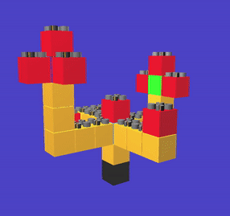
Sources:
Naz, A., Piranda, B., Goldstein, S. C., & Bourgeois, J. (2016, February). A time synchronization protocol for modular robots. In Parallel, Distributed, and Network-Based Processing (PDP), 2016 24th Euromicro International Conference on (pp. 109-118). IEEE.
Gao Q., Blow K. J., Holding D. J. Simple algorithm for improving time synchronisation in wireless sensor networks //Electronics Letters. – 2004. – Т. 40. – №. 14. – С. 889-891.
OMNI Team (FEMTO-ST/DISC/OMNI)
https://www.youtube.com/channel/UCUFwQq2i-s_gFhTJ0l2-PBQ
17
Programmable matter
https://projects.femto-st.fr/programmable-matter/synchronization

